Slide 1

DELIVERABLE 4
Fall 2020 Capstone Project | Professor Henry Wong
Team members:
Alan Singleton
Briana Figueroa
Jasmine Washington
Morgan Franklin
Sayema Islam
Swapnil Kadekar

Slide 2
agenda
Project Overview
Project Requirements
Design Architecture
Sprint Recap
Test Cases
Project Demo (MVP)
GitHub Walkthrough
Retrospectives
Conclusion

Slide 3
Project Overview

Slide 4
Project Overview
What?
-Image-based Self diagnosing web application
How?
-User image submission
-Trained machine learning-based model
- Results and information
Why?
-Does not require login
- No long sequence of questions
- Image-based

Slide 5

Project Requirements
This Photo by Unknown Author is licensed under CC BY-NC-ND

Slide 6
Project requirements
Upload Image
Find Nearest Emergency Room
Receive Results
Send Feedback

Slide 7
Project requirements – user stories
ID​ | As a​ | I want to​ | so that​
US3​ | user​ | upload a photo/image of my symptom/affected area/illness​ | the SYMCheck application can diagnose me and I can gain insights as to what I might be afflicted with​
US12​ | user​ | find the nearest emergency room​ | I can receive immediate medical attention if it is deemed necessary​
US10​ | user​ | know what information I can obtain about this/any illness I might potentially have​ | I can gain an understanding of what might be causing my symptoms, and thus make an informed decision on how best to go forth with my care​
US16​ | user​ | get in touch with the creators of the SYMCheck application​ | I can provide the creators of the SYMCheck application with suggestions/comments, ask them questions, commend them for their product, etc.​

Slide 8
Design Architecture

Slide 9
Django Architecture
Client Side
Django Template (HTML, CSS, Javascript)
Server Side
App Logic
View Logic
Django Framework
Model
Database (SQLite3)

Slide 10
SymCheck Design
Client Side
Django Template (HTML, CSS, Javascript)
Server Side
View Logic
Media
SymCheck’s Django Framework
Model

Slide 11
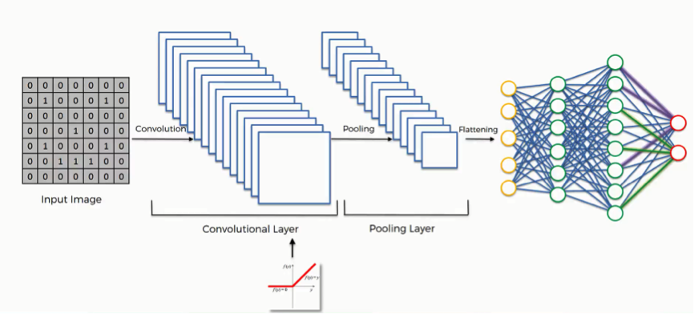
Machine learning algorithm
Convolutional Neural Network (CNN) -

Slide 12
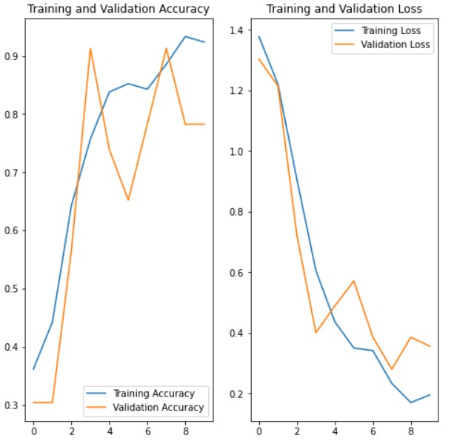
Model Evaluation

Slide 13

Timeline of Implementation Sprint Recap
This Photo by Unknown Author is licensed under CC BY-NC-ND
Notes:
Hi everyone, I'm Sayema, and I'll be giving you all a quick rundown of the work done in our sprints during the course of this semester.

Slide 14
What is Agile Development?
INDIVIDUALS AND INTERACTIONS | over | processes and tools
WORKING SOFTWARE | over | comprehensive documentation
CUSTOMER COLLABORATION | over | contract negotiation
RESPONDING TO CHANGE | over | following a plan

Slide 15
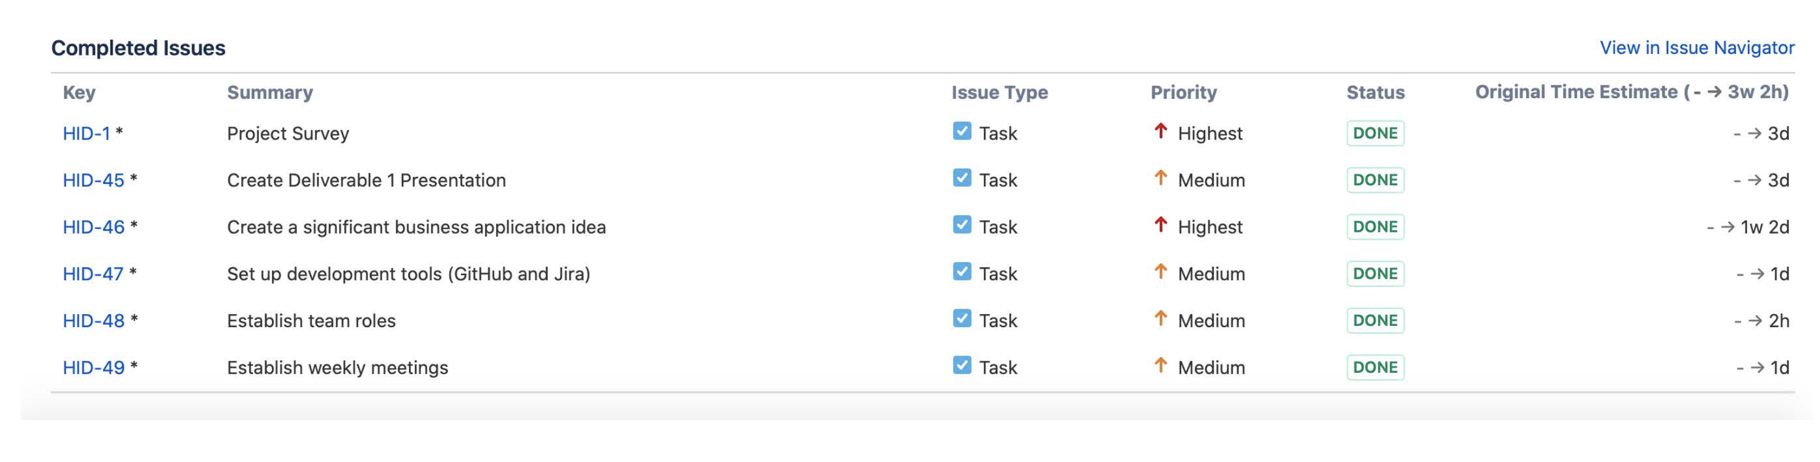
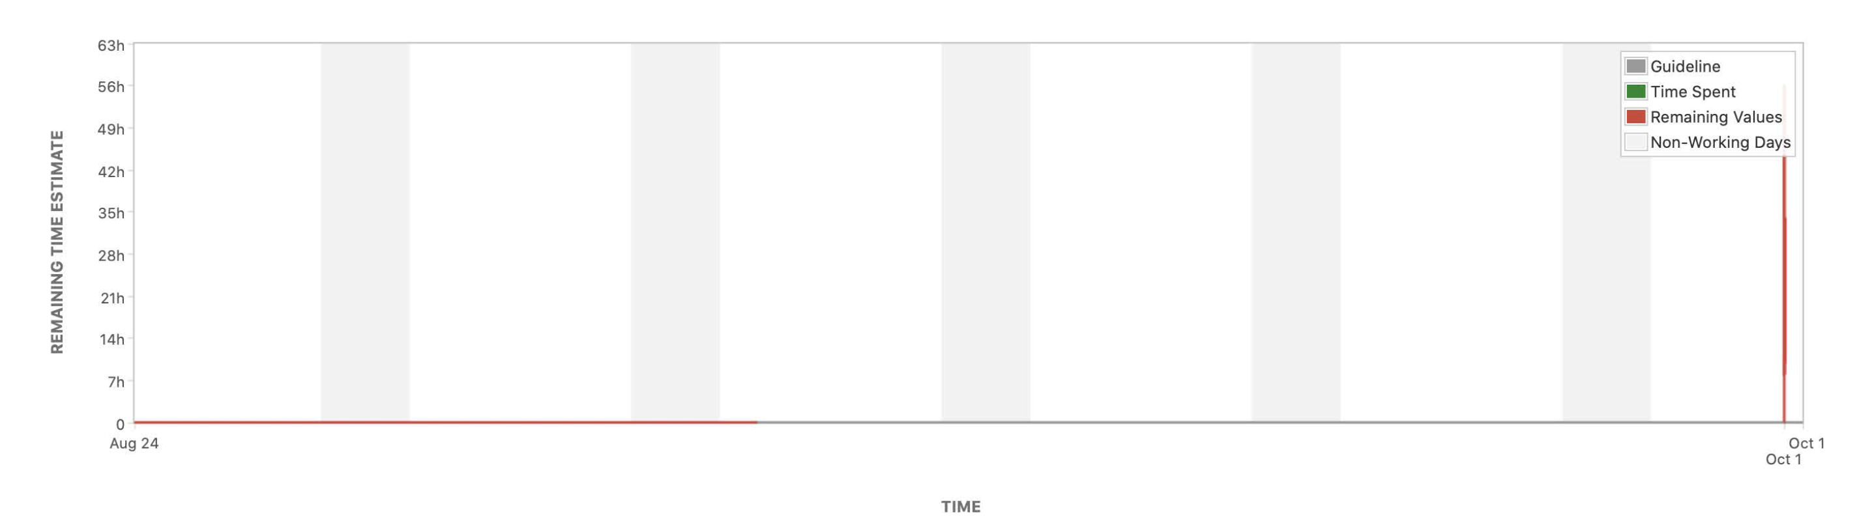
Review of Sprint 1 (08/24 - 09/21)

Slide 16
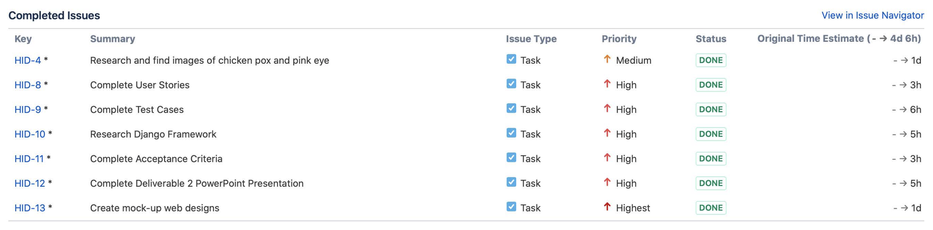
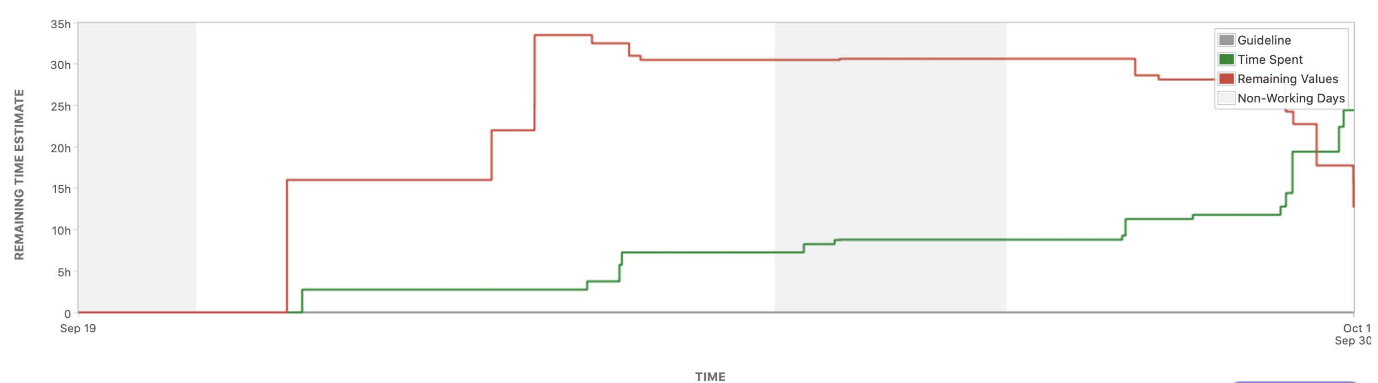
Review of sprint II (09/22 - 10/05)

Slide 17
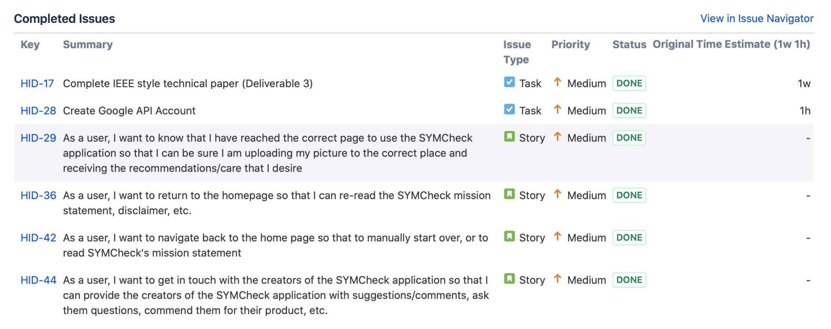
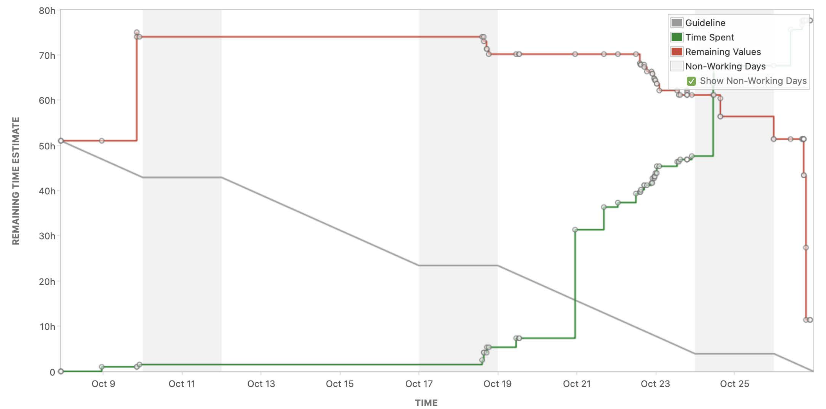
Review of Sprint III (10/06 - 10/26)

Slide 18
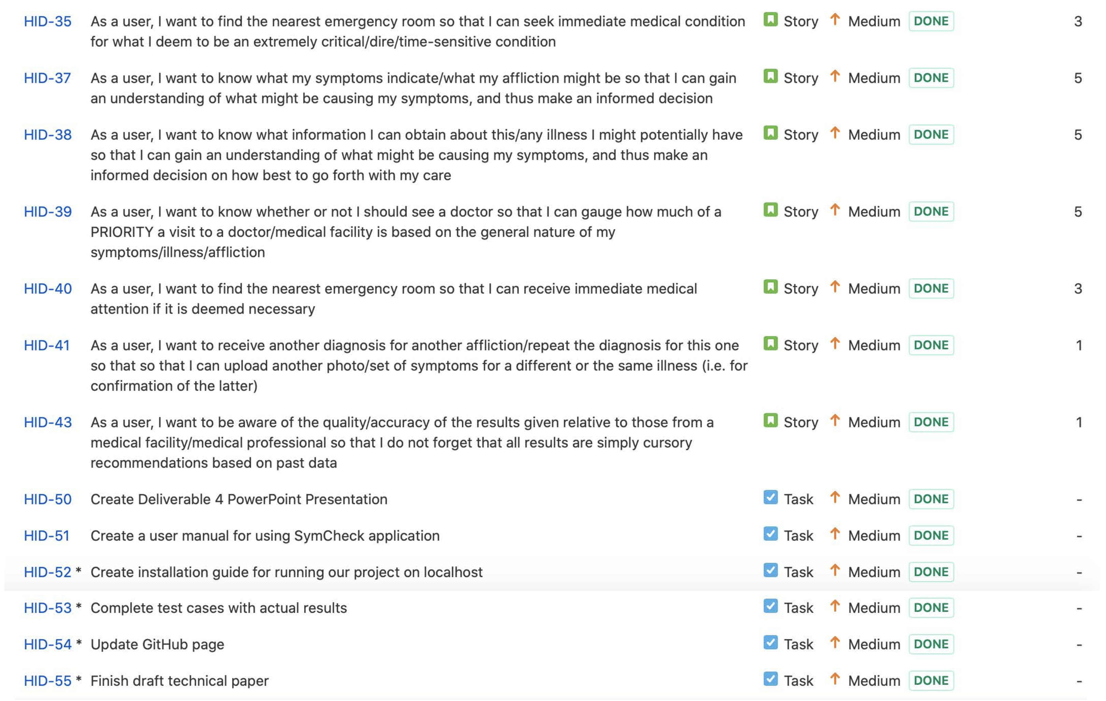
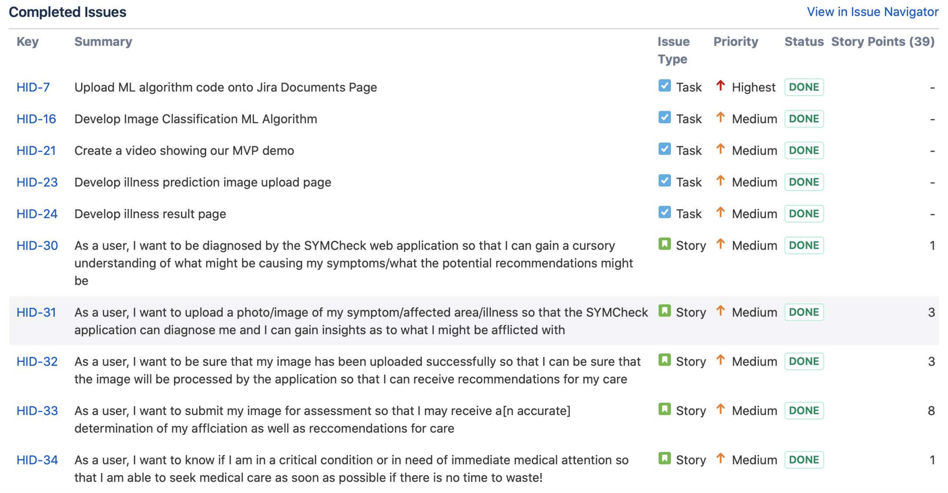
Review of Sprint IV (10/27 - 11/23) - Tasks

Slide 19
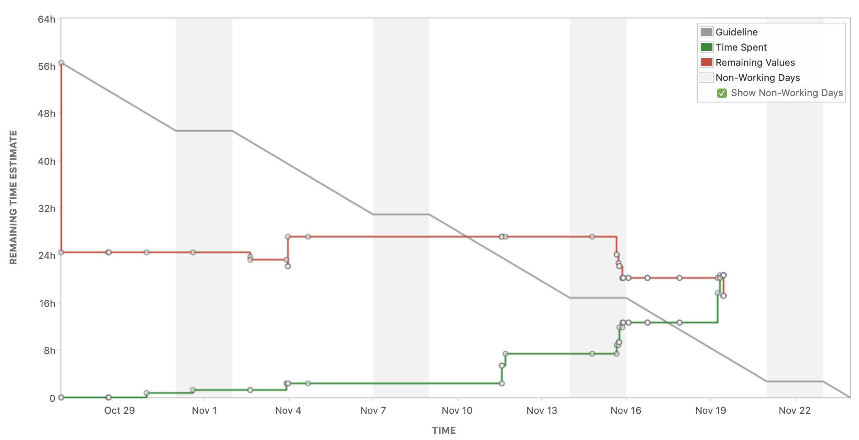
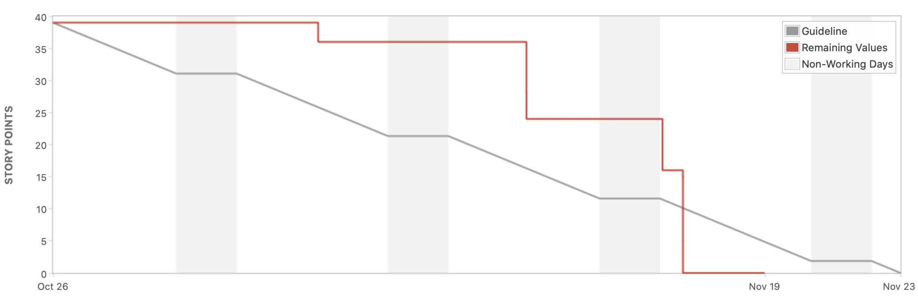
Review of Sprint IV (10/27 - 11/23) - burndown charts

Slide 20

Test cases
This Photo by Unknown Author is licensed under CC BY-NC-ND

Slide 21
Test cases – Homepage
Test Case For | ID | Test Cases | Test Data | Expected Results | Actual Results | Pass/Fail
Homepage | 1 | Browse the Website |  | User should be able to access the homepage of the website | Once directed to site, you will first be directed to the homepage of SymCheck | P
 | 2 | Locate the Get Diagnosed Link |  | User should be able to locate the link to access the upload page | Click link Get Diagnosis Now to be redirected to upload page | P

Slide 22
Test cases – image Upload
Test Case For | ID | Test Cases | Test Data | Expected Results | Actual Results | Pass/Fail
User Input Page | 1 | Locate the Submit Photo Link |  | User should be able to locate the link to submit photo | Next to the upload image button there is a button to submit the photo | P
 | 2 | Choose file shows up |  | User should see choose file option, to upload photo to website | Once you click the choose file button you will be redirected to upload a file from your computer | P
 | 3 | Drag and Drop feature |  | User can drag and drop the photo in the box for uploading | This feature will be completed in the next semester | F
 | 4 | Ability to cancel uploading file |  | User should be able to cancel the file from being uploaded | When selecting the file to upload you are prompted with the option to cancel. If you click cancel the file won't upload to the page. | P
 | 5 | Verify file is uploaded |  | User should not be able to click on the submit button without submitting a file | If you try to select the submit button without uploading an image, you are prompted to please select a file | P
 | 6 | Verify file is correct |  | User should be promoted to verify uploaded file is correct | When uploading the file, the user can see what image they are uploading and cancel the process if it is not the right image. | P
 | 7 | Submit to website for analysis |  | User should be able to click submit to send correct photo to be analyzed | Once uploading the image click the submit button and the algorithm begins analyzing the photo for results | P
 | 8 | Locate the Nearest ER Link |  | User should be able to locate and click the Nearest ER link to access an interactive map | Under the logo, there is the Nearest ER link. Clicking this button, you can access google maps to show hospitals nearby. | P
 | 9 | Return to Homepage Link |  | User should be able to return to the homepage when clicking the Home button | At the bottom of the page when clicking the home button, you are redirected to the homepage of Symcheck | P

Slide 23
Test Case – Image functionality
Test Case For | ID | Test Cases | Test Data | Expected Results | Actual Results | Pass/Fail
Image functionality | 1 | Check for image file extension |  | User can only upload certain types of file extensions (Verify if incorrect) | When uploading a file you can only open a jpg or png. No other extensions will be allowed to be uploaded | P
 | 2 | Check for size of the image file |  | If file is too large to upload, the user must be notified | If file is too large, it will be resized to fit a specific measurement before being processed in the Machine Learning | P
 | 3 | Check for height and width |  | Image should be measuring a certain height | Before preprocessing is done, the image is resized to be 200 length and 200 width. That way the images are processed at the same size. | P

Slide 24
Test cases – results
Test Case For | ID | Test Cases | Expected Results | Actual Results | Pass/Fail
Results | 1 | Results appear after analysis complete | User will see percentage that they have the illness | In the Results box it displays the likely hood of the image being an illness. | P
 | 2 | About the disease | User will see facts about the disease they have been diagnosed with | If the image is likely to be Chickenpox or Pink Eye, then the About box will give information about the illness and a link to the CDC website. If the image is not likely to be chickenpox or Pink Eye, then the section will say that the algorithm isn't detecting an illness | P
 | 3 | When to see a Doctor | User will see when it is best advised to see a doctor | In the When To See A Doctor section, it will state when it is best advised to seek medical attention and includes the symptoms that can occur or become worse | P
 | 4 | Nearest ER | If selected, user will be able to access an interactive map | Towards the bottom of the page there is a Nearest Emergency Room section. Where you can click the Nearest Emergency Room button and google maps pops up with Emergency Rooms nearby your location. | P
 | 5 | New Diagnosis Link | User should be able to access the user input page for a new diagnosis | In the top right corner there is a button called new diagnosis, where you will be redirected to the upload image page to upload a new image to diagnose | P
 | 6 | Return to Homepage Link | User should be able to return to the homepage when clicking the Home button | In the top left corner there is a Home button, when clicking this button you will be redirected to SymChecks homepage | P
 | *7 | Error Message | User should see an error message if there is any issue with their uploaded image. | If the user deletes their browser history and tries to refresh the page, the results won't exist anymore, and this will cause the user to submit photo again. | P

Slide 25
Test cases – feedback
Test Case For | ID | Test Cases | Test Data | Expected Results | Actual Results | Pass/Fail
Feedback | 1 | Send user feedback |  | User can click button to send feedback about application | Located at the bottom of the Results Page, there is a Feedback section. You can click Contact Us Here to send the team a message. | P
 | 2 | Fill out feedback |  | User will be prompted to type their feedback about the application | Once the Contact Us Here was clicked you will be redirected to an email where the email address and subject are already filled out. All you have to do is fill out the message you would like to send. | P
 | 3 | Submit Feedback |  | User can submit feedback and will have a response within 24 hours | Once the email is ready to be sent, the user can send the email and the team will respond back shortly. | P

Slide 26

Project Demo
This Photo by Unknown Author is licensed under CC BY-NC-ND

Slide 27


Github Walkthrough
Notes:
https://github.com/jazzymaya/HiddenAgility/wiki

Slide 28

Retrospectives
This Photo by Unknown Author is licensed under CC BY-NC-ND

Slide 29
Retrospectives
What went well
Completing our work on time
What needs improvement
Meeting times
Next Steps
Find a code collaboration tool
Marking user stories as complete on Jira
Communication among team members
Coding redundancies
Establish a better availability window for meetings

Slide 30

Conclusion
This Photo by Unknown Author is licensed under CC BY-NC-ND

Slide 31
Conclusion
Application Recap
SymCheck facilitates the lives of users
Currently diagnosises chickenpox and pink eye
Provides:
Model results
Information on the illness
Location of the nearest hospital
Future Scope
Chatbox AI
Textual symptom submission
Adding other illnesses

